Slide 1
Virtual public meeting
STRATEGIC DEVELOPMENT DEPARTMENT
December 15, 2021

Slide 2
Submitting comments & Translation services
Virtually or in-person meetings
Mail comments to:
Omnitrans
Strategic Development Dept.
1700 W. 5th Street
San Bernardino, CA 92411
Email: planning@omnitrans.org
Call: 909-379-7342
Online comment form:
omnitrans.org/publichearings21
Spanish translation is available at the virtual public meetings
If you require translation services for other languages, please let us know
Submit comments by December 31, 2021

Slide 3
Temporary suspension of Route 290

Slide 4
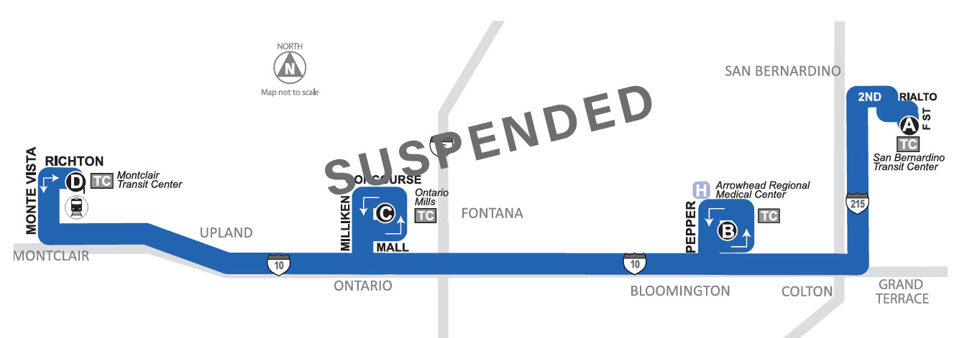
Local service to route 290 stops
Routes: 1, 2, 3, 4, 6, 8, 10, 14, 15, 215, sbX, OmniAccess
Routes 66 & 14
Routes: 66, 84, 85, 88, OmniRide Upland
Routes: 61, 81, 82
Routes: 1, 19, 22
All four Route 290 stops still served by Omnitrans local fixed routes

Slide 5
THANK YOU
Upcoming Public Hearings
CITY/ COMMUNITY | LOCATION | DATE | TIME | ROUTES TO MEETING
Virtual Meeting* | Online | Wednesday, | 6:00 P.M. – 7:00 P.M. | Online
 |  | December 15, 2021
Montclair | Montclair Transit Center | Thursday, December 16, 2021 | 7:00 A.M. – 9:00 A.M. | 66, 84, 85, 88, 290, OmniRide Upland
San Bernardino | San Bernardino Transit Center | Friday, December 17, 2021 | 6:00 A.M. – 8:00 A.M. | 1, 2, 3, 4, 6, 8, 10, 14, 15, 215, 290, 305, sbX, OmniAccess

